Slide 1
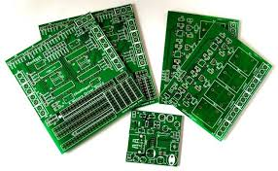
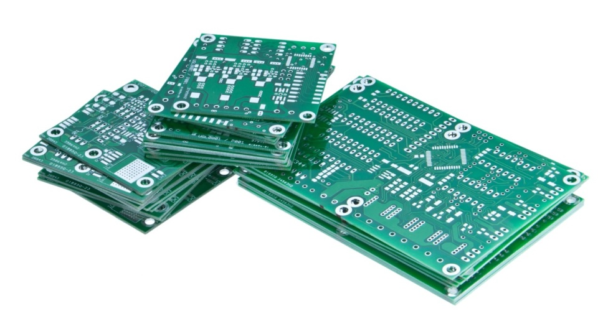
PCB FABRICATION : FOR HIGH POWER ELECTRONICS

Slide 2

EUCLIDS LABS,DEHRADUN
It is an R&D lab in Dehradun and currently they are working on developing efficient and inexpensive substitutes for Metal Clad Printed Circuit Boards (MCPCB) used in high power LED lights.
Start-up by Tarun Jha (CEO of Euclids Labs)

Slide 3
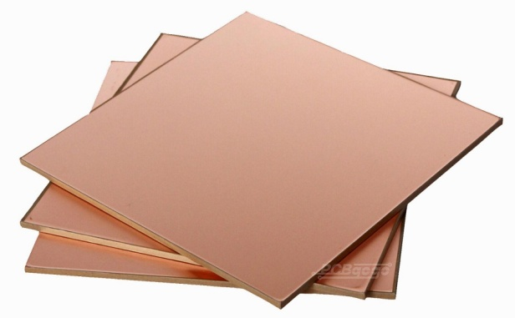
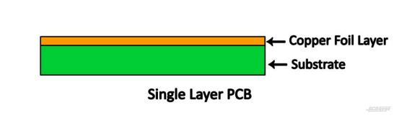
PRINTED CIRCUIT BOARD(PCB)
A PCB is a thin board in which conductive pathways are fabricated onto board, connecting different components on the board such as transistors, resistors, and integrated circuits.
TOP VIEW
CROSS-SECTIONAL VIEW

Slide 4
PCB MADE OF...
PCBS are made of
FR4
Flame Retardant
LIMITATIONS :
POOR FLEXIBILTY
POOR THERMAL CONDUCTIVITY(O.25-0.4 W/m.k)
Low Glass Transition Temperature ( 120-140 deg C)
Low luminous efficiency
Fibre glass reinforced epoxy

Slide 5
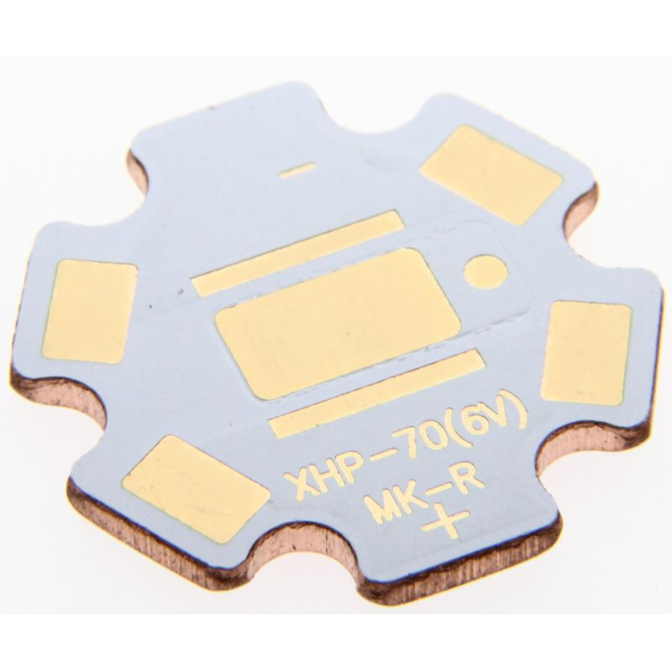
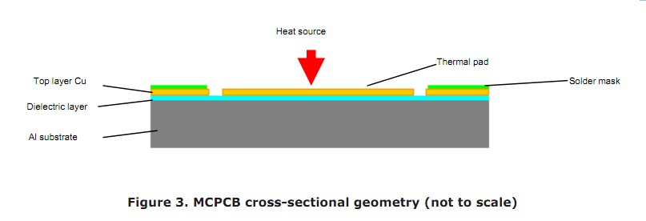
Metal Clad Printed Circuit Board (MCPCB)
FR4
Aluminium or Copper substrate

Slide 6
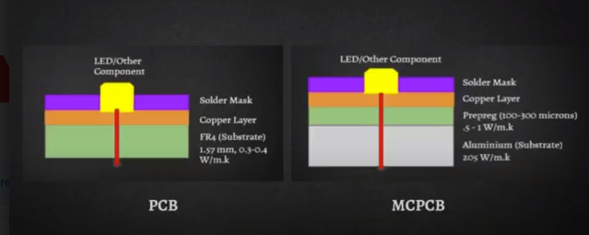
PCB v/s MCPCB (heat dissipation )

Slide 7
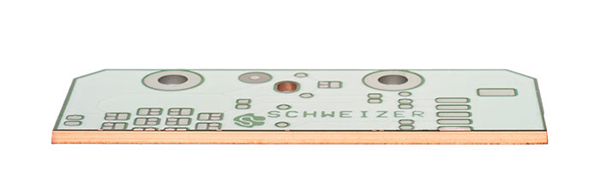
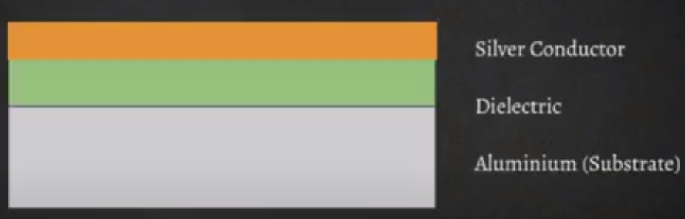
INSULATED METAL SUBSTRATE (IMS)
Circuits are mounted directly on Al substrate.
More efficient and cheaper than PCBs and MCPCBs.
CROSS SECTIONAL VIEW

Slide 8
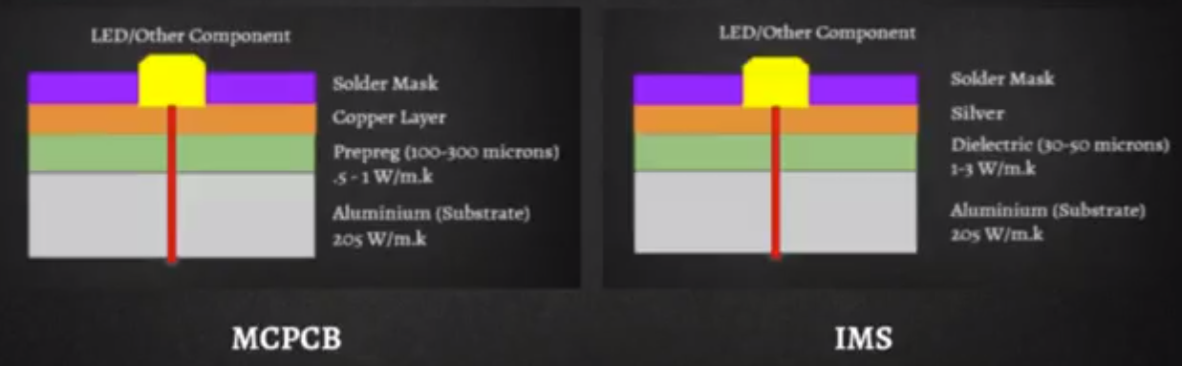
MCPCB v/s IMS (heat dissipation)

Slide 9
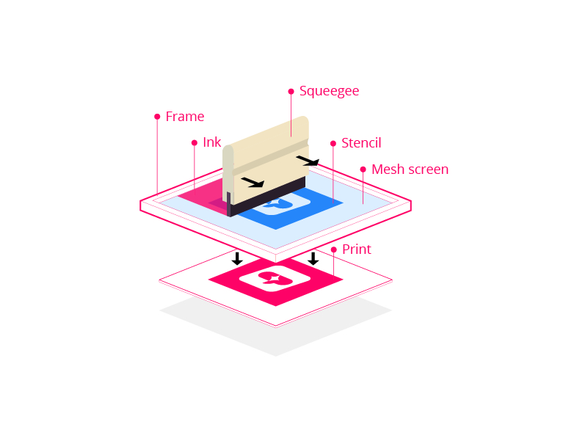
SCREEN PRINTING
Screen printing is a printing technique where a mesh is used to transfer ink onto a substrate, except in areas made impermeable to the ink by a blocking stencil.

Slide 10
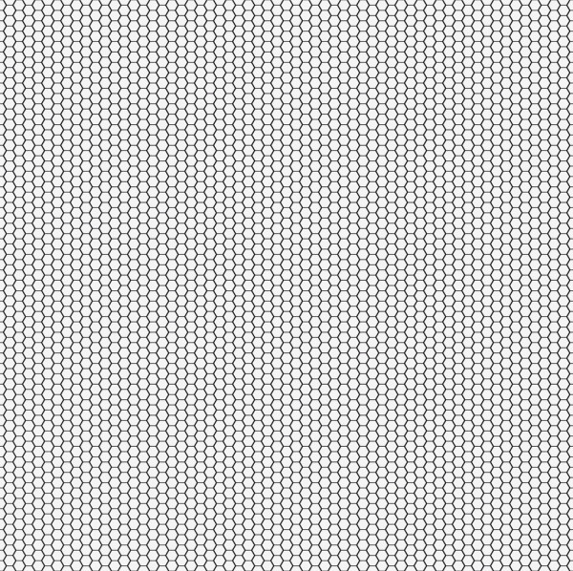
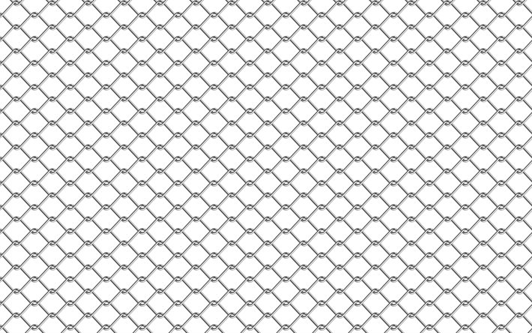
Mesh Classification
Mesh number: Number of opening per inch(linearly)of a mesh
LOW HIGH
Material type: Nylon , Polyester , Stainless Steel

Slide 11
IMS Manufacturing Process
Substrate cleaning
Dielectric layer
a)Printing(100 mesh , snap off
+
Levelling (Room Temp 10 minutes )
b)Drying (150-200 degC 5-8 minutes)
+
Firing(at 570 degC 7minutes)
Conductor layer

Slide 12

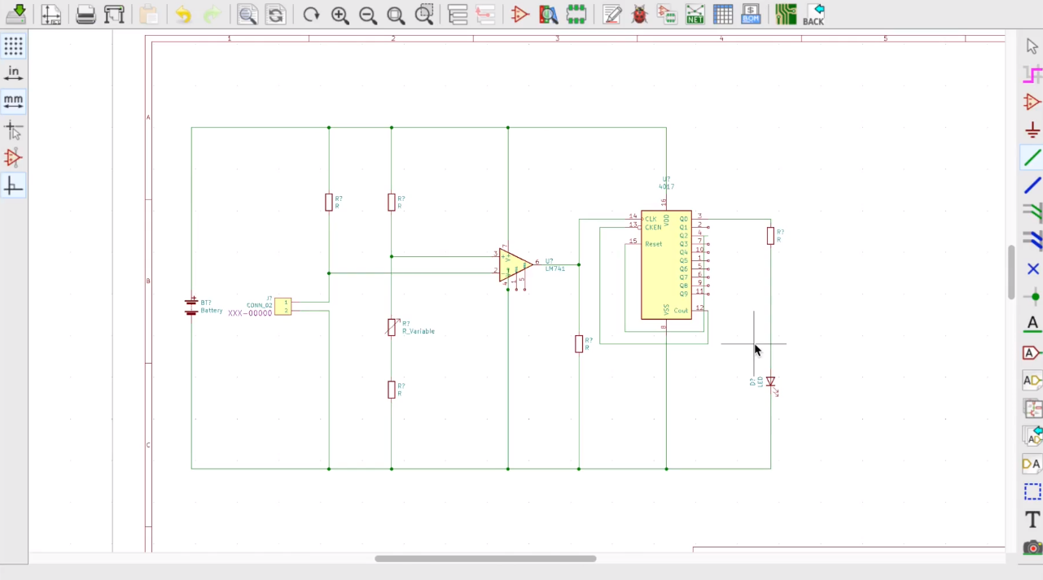
Project using KICAD
Schematic diagram of CLAP CIRCUIT

Slide 13
Steps for Fabrication
Schematic diagram using KICAD.
Cleaning of copper board to remove oxidized layer.
Pattern transfer.
Etching using FeCl3.
Cleaning of ink.
Drilling of holes.
Soldering components.

Slide 14
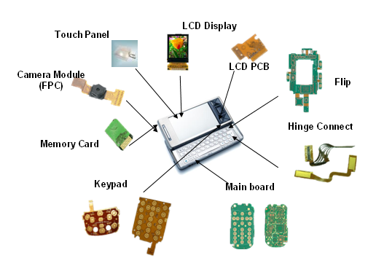
APPLICATIONS OF PCB

Slide 15
REFERENCES
www.euclidlabs.in
Course-PCB fabrication
- Videos and study material by
Tarun Jha (CEO)

